Slide 1

WHO AFRO NETWORK OF PARTNER INSTITUTIONS
Enhancing SRHR Workforce Development in Africa
JKUAT’s Contribution to WHO AFRO Pillar 2 Initiative
Jomo Kenyatta University of Agriculture and Technology (JKUAT)
27th January 2026, Nairobi - Kenya

Slide 2
Introduction
Jomo Kenyatta University of Agriculture and Technology (JKUAT)
Established in 1981; a leading public university in Kenya.
Over 35,000 students across 6 colleges and 23 schools.
Core focus: STEM, research, innovation, and community engagement.

Slide 3
The JKUAT Project Team
A Multidisciplinary Expert Group
Prof. Anthony Waititu – Dean, School of Mathematical & Physical Sciences (Strategic Lead)
Dr. Charity Wamwea – Chair, STACS (Departmental Leadership)
Dr. Joseph K. Mung’atu – PI/Technical Lead (Statistical Modelling)
Dr. Jane A. Akinyi – Co-I (Health Statistics & Research)
Dr. Winnie Chacha – Co-I (Financial Modelling & Statistics)
Dr. Ann Omamo – Co-I (Human Resource Management)
Mr. Henry Kissinger Ochieng – Co-I (Statistics)
Ms. Caro W. Mugo – Co-I (Statistics)
Dr. Matabel Odin – Co-I (Financial Mathematics)
Supported by institutional grants office and admin staff.

Slide 4
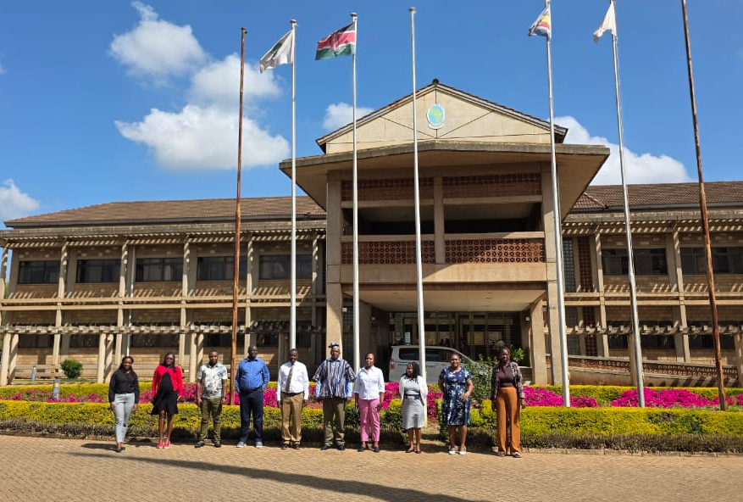
The JKUAT Project Team

Slide 5
Mandate of the JKUAT Team
Aligned with WHO AFRO Network Of Partner Institutions
Pillar 2 & Regional HRH Strategy “Support research and knowledge translation on workforce needs, planning, productivity including developing tools for workplace deployment, retention, continuing professional development”
Conduct operational research to inform:
Workforce production, retention, deployment, and productivity.
Investment models (ROI, human capital gains).
Generate actionable evidence to support:
HRH policy reform
SRHR competency integration
Data-driven decision-making for the UHC and SDGs.

Slide 6
Progress: Inception & Evidence Synthesis
Activities Underway (Jan 2026)
Inception Meeting Held (20–21 Jan 2026):
Team alignment on project objectives and deliverables.
Detailed planning for Evidence Synthesis phase.
Evidence Synthesis Phase Initiated:
Desktop review of SRHR workforce data/literature.
Mapping workforce stock, training pathways, and gaps.
Engaging Machakos County CHMT for local data and context.

Slide 7
Revised Project Timeline (Jan–Apr 2026)
January 2026: Project inception, team mobilization, and evidence synthesis launch.
February 2026: Complete gap analysis; begin ROI and productivity modelling.
March 2026: Validate models with stakeholders; draft policy briefs and tools.
April 2026: Finalize reports, disseminate findings, and submit deliverables to WHO AFRO.

Slide 8
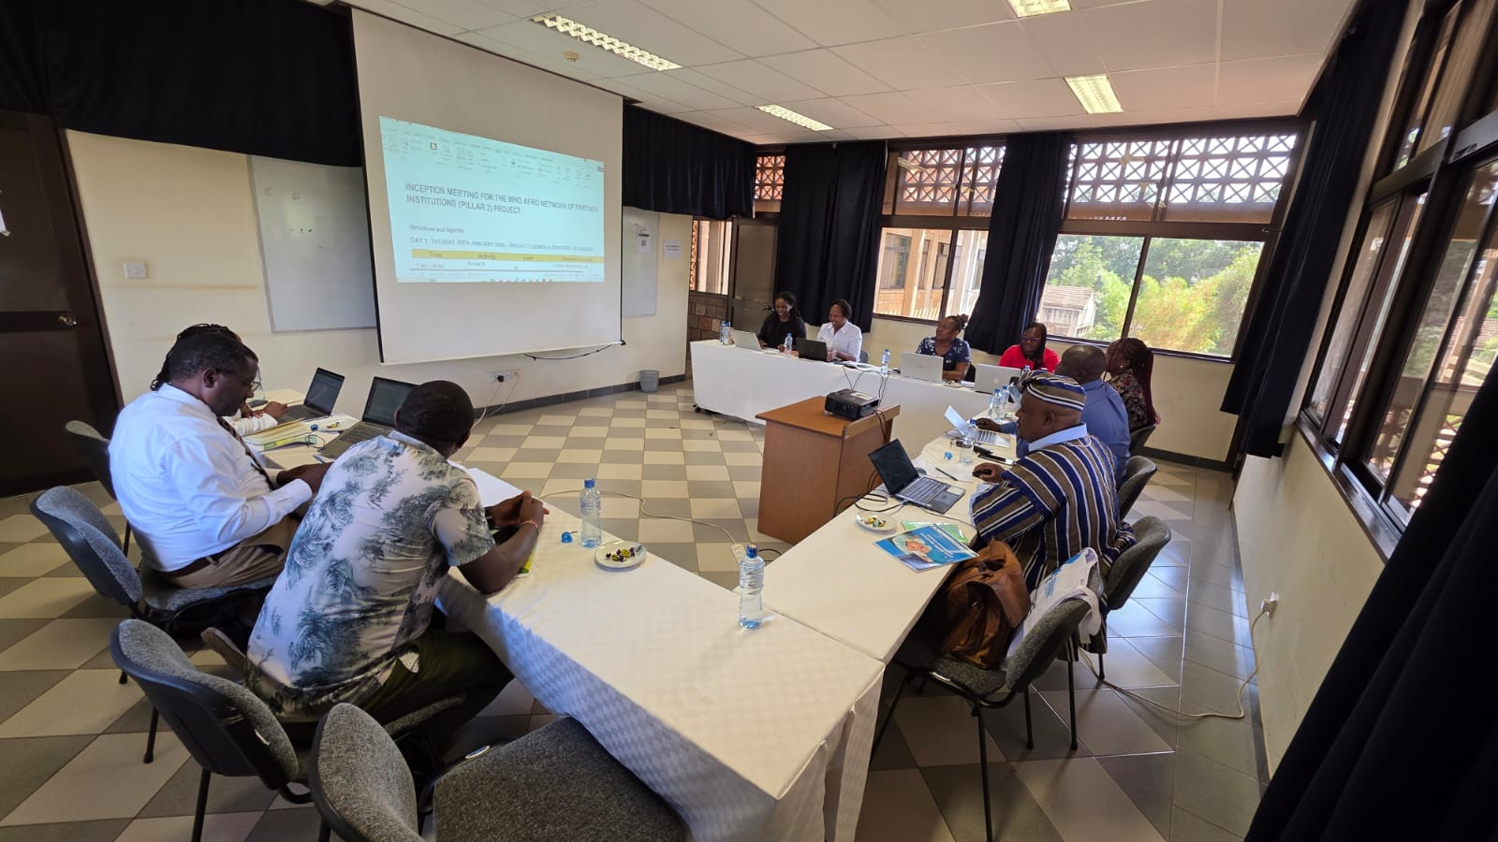
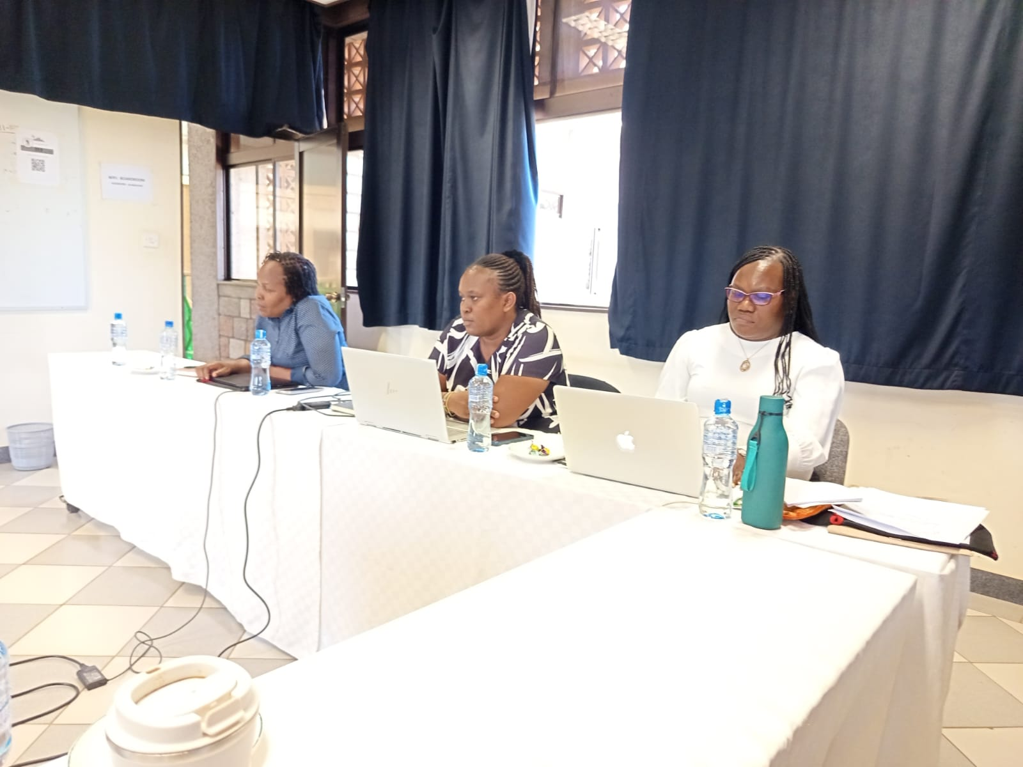
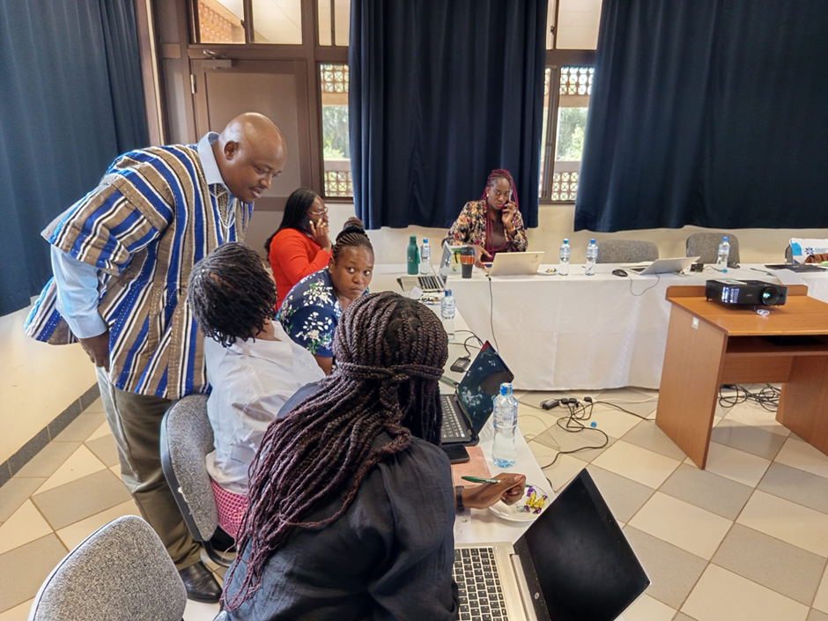
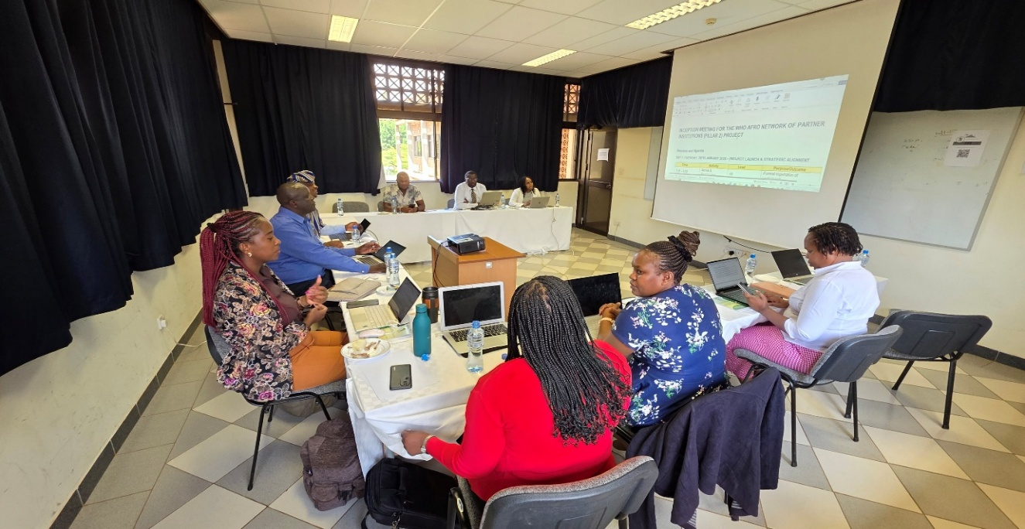
Working sessions – photos

Slide 9
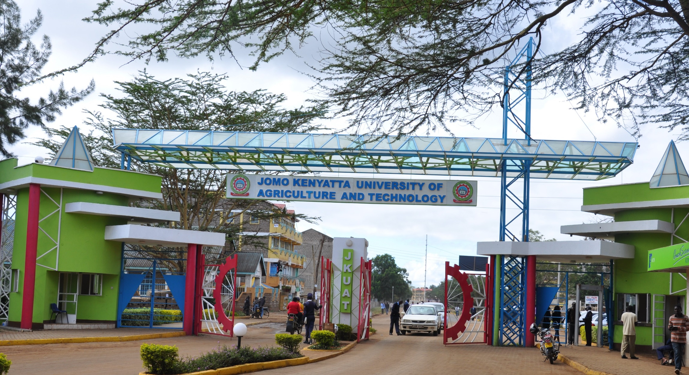

Slide 10
Thank you

